Slide 1

Title: E-commerce Sales Data Analysis Subtitle: Insights from 401 Transactions – Excel-Based Portfolio Project Asma’a Hakami – 7 May 2025

Slide 2

Introduction
This project analyzes a sample of e-commerce sales data to extract insights into customer behavior, product performance, and overall sales trends. The analysis was done entirely in Microsoft Excel and is intended to demonstrate practical data analysis skills on a real-world dataset.

Slide 3

Dataset Overview
Source: Kaggle
Total Records: 401 rows
Total Features (Columns): 9
Data Type: Transaction-level sales data
Key Columns Include:
Order ID
Order Date
Customer Name
Category
Quantity
Price
Total Sales
Product
Region

Slide 4

Key Business Questions
Which products generate the most revenue?
What days or months see the highest sales?
Which regions have the highest customer engagement?
Which products is the less profitable?

Slide 5
Data Cleaning Summary
Removed any duplicate rows
Handled missing values in customer name
Calculated the max, min, sum, average values
Converted dates to a usable format for time-based analysis

Slide 6

Product Performance
Top-selling products were identified by aggregating total quantity and revenue. [Microwaves, Notebooks,Novels]. This helps determine which items drive the most value.

Slide 7
Sales Trends Over Time
Analyzed daily and monthly sales volume.
Key Findings:
Peak sales in January
Suggests seasonal or promotional effects

Slide 8

Visualizations
Charts created in Excel to support insights:
Pie chart: Products by Revenue
Line chart: Yearly Sales Trends
Bar chart: Total Sales by Region and Product

Slide 9
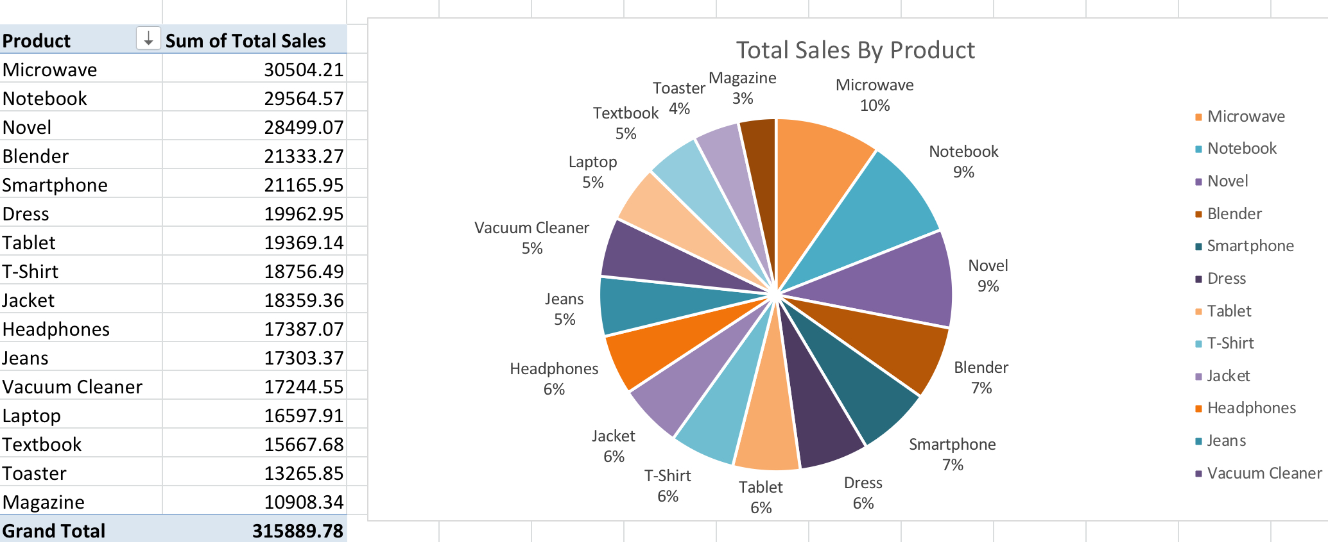
Pie chart

Slide 10
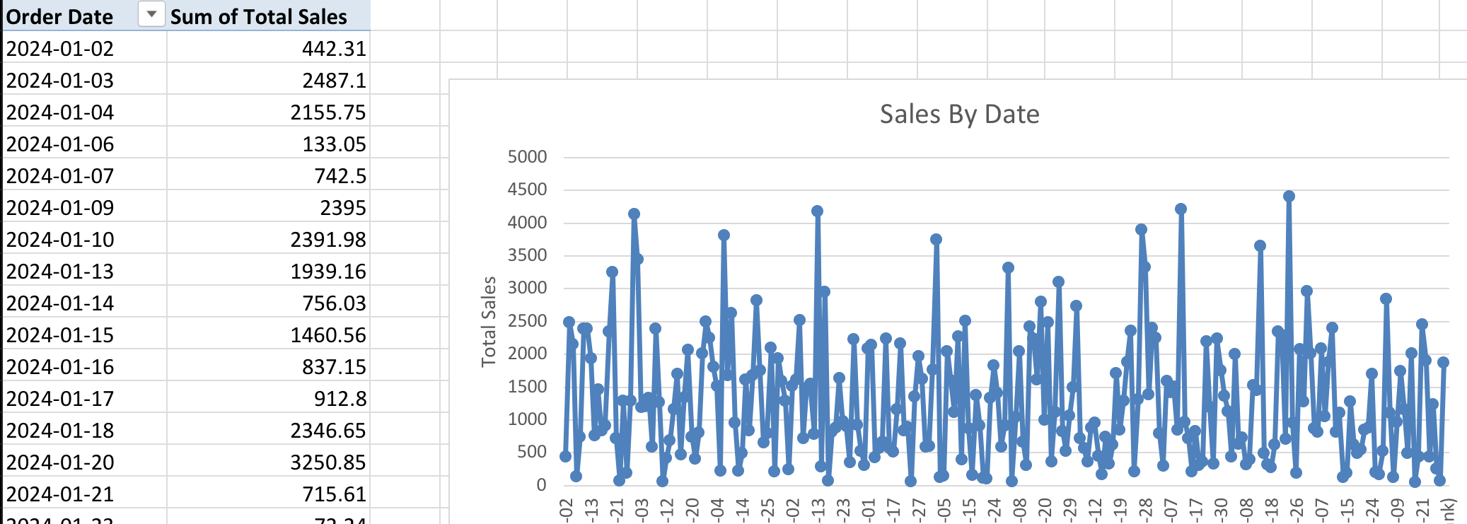
Line chart

Slide 11
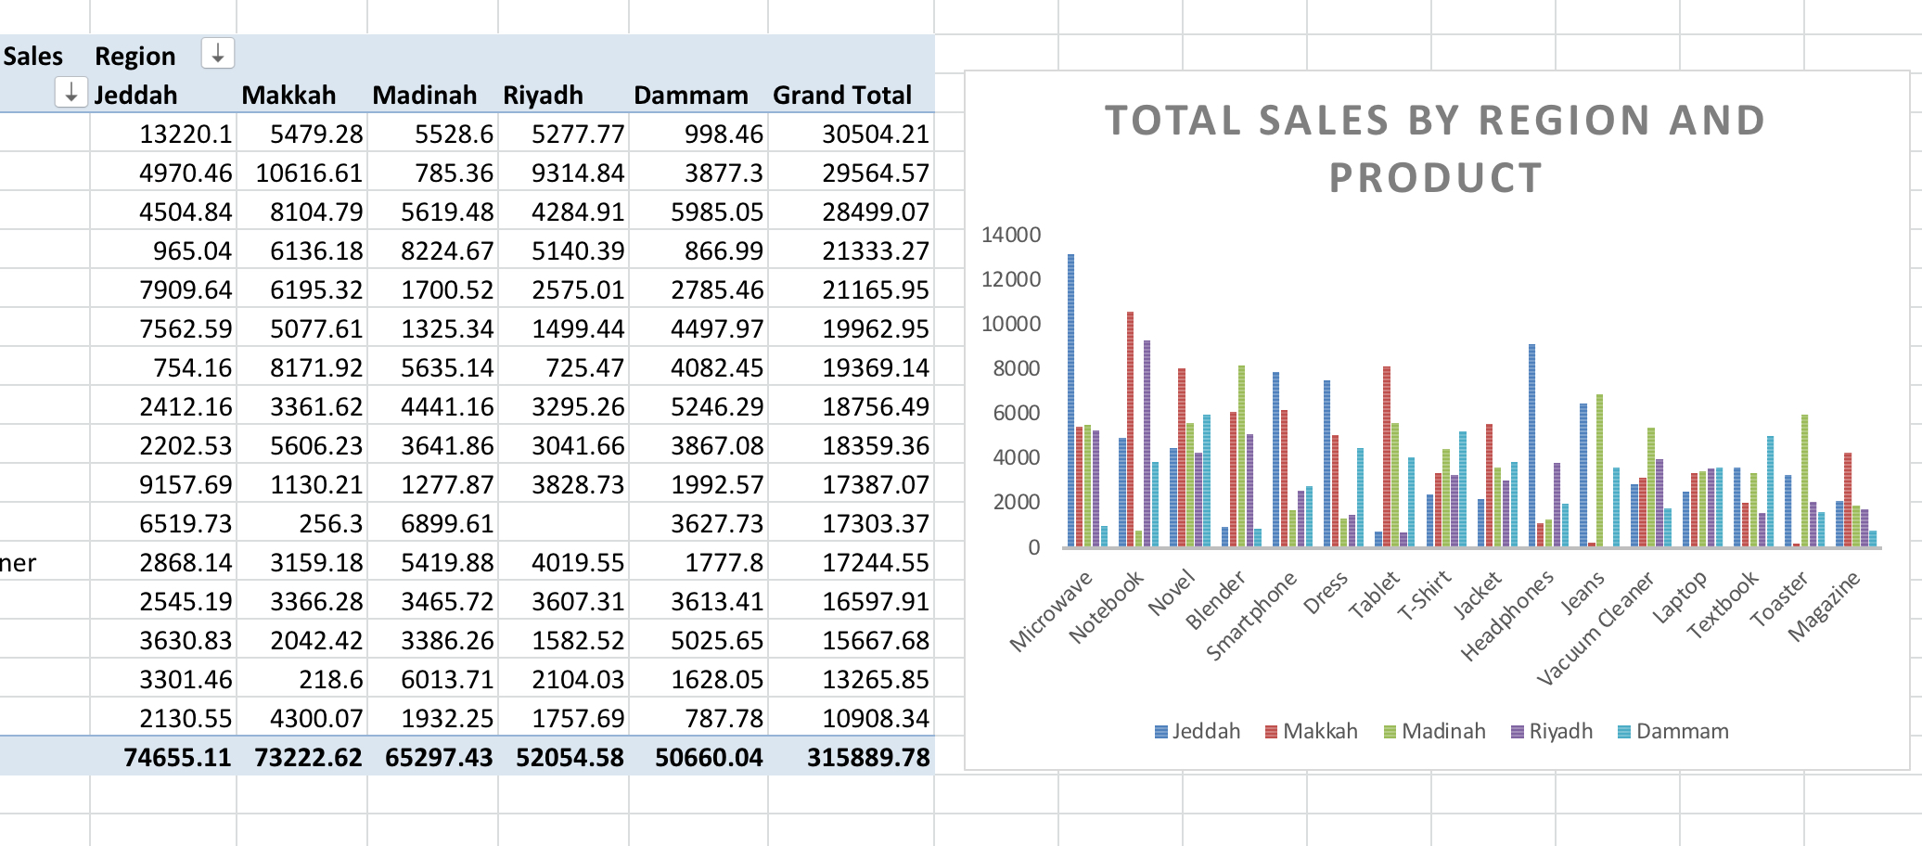
Bar chart

Slide 12
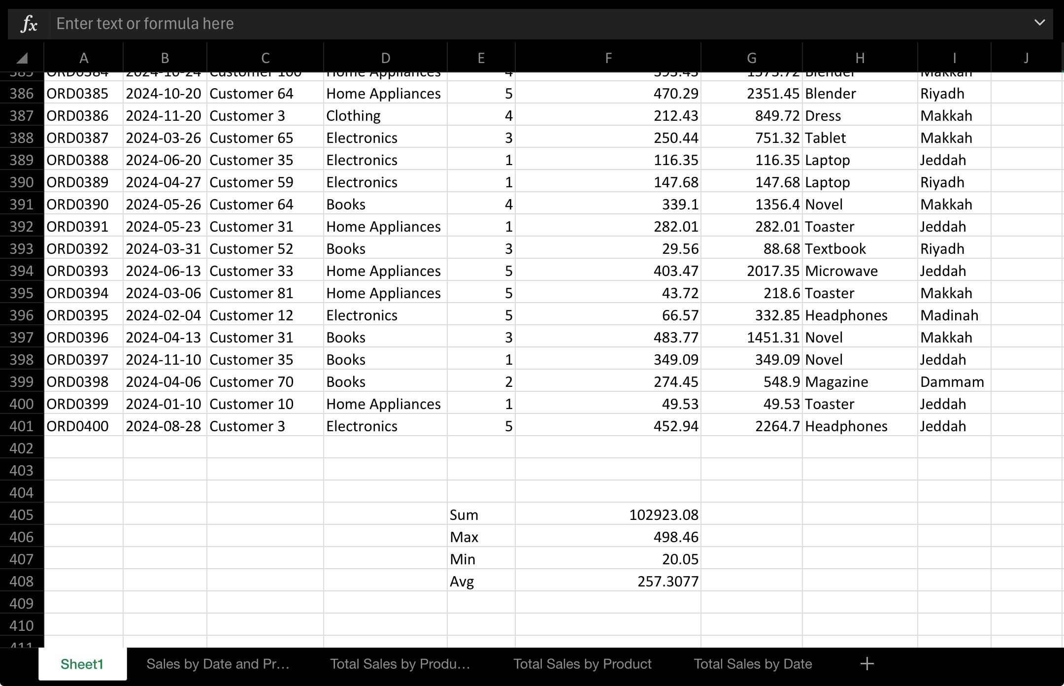
Excel Snapshot

Slide 13
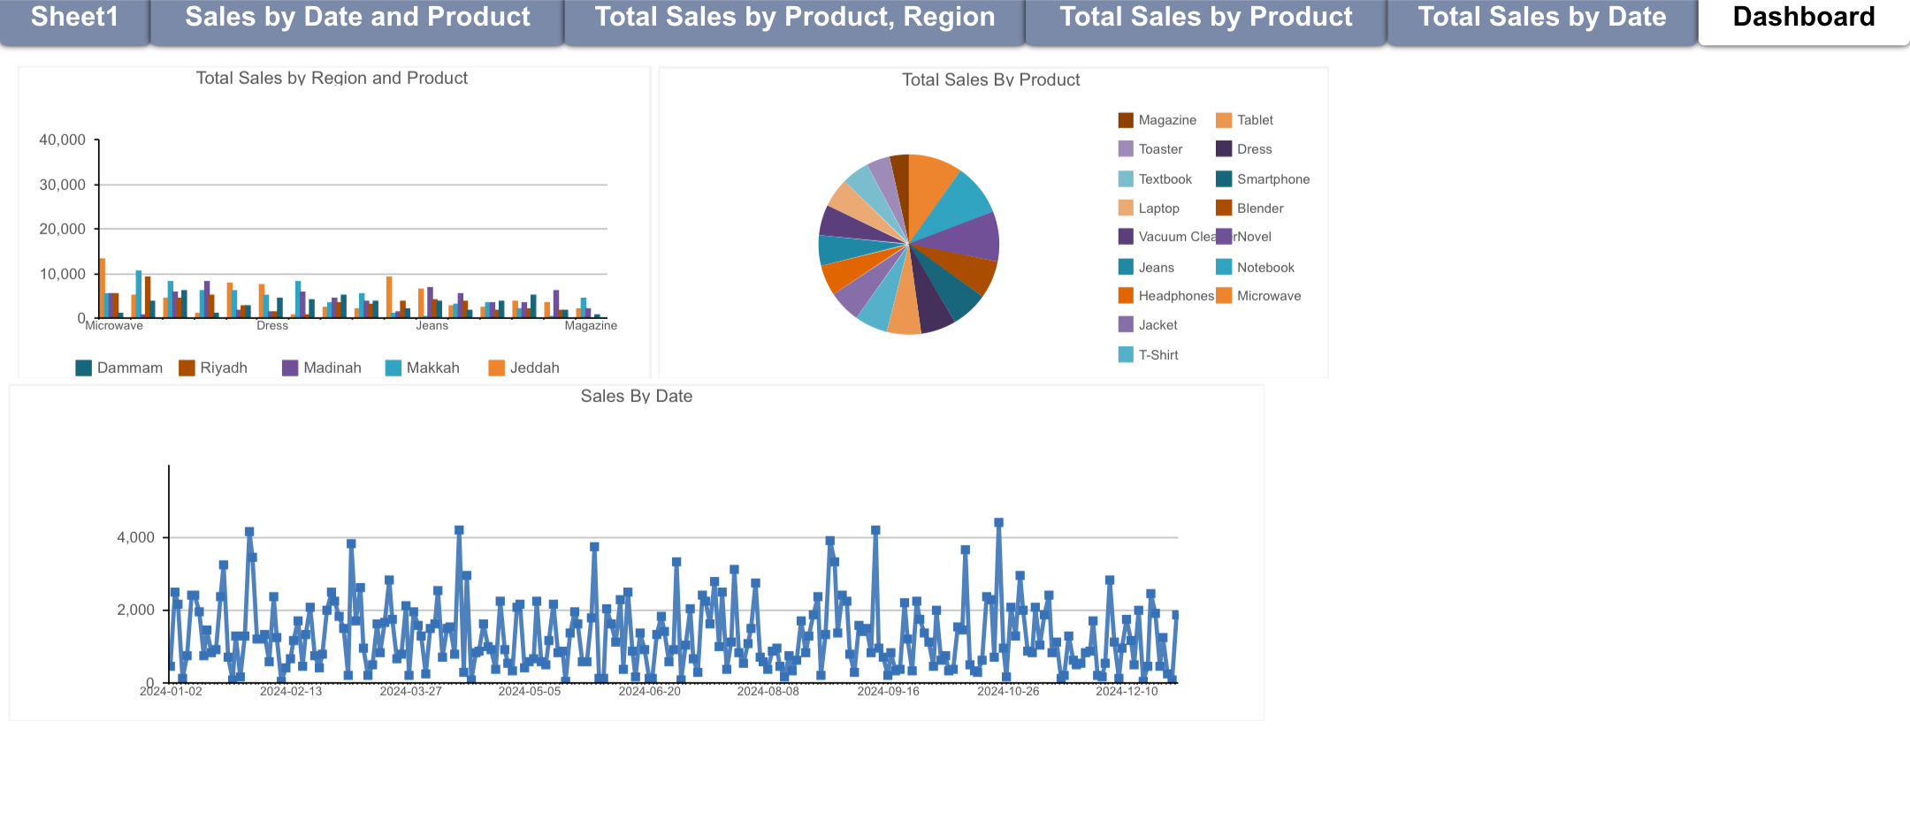
Dashboard

Slide 14

Insights
Best-selling item: Microwave ovens, indicating high demand compared to other products.
• Highest-profit day: October 24, 2024, likely coinciding with a promotion or buying season.
• Performance by region:
• Jeddah had the highest sales, indicating a strong market there.
• Dammam recorded the lowest sales, calling for an investigation into the reasons for its weak performance.
• Least-profit product: Magazines, which could indicate weak demand or low profit margins.

Slide 15
Conclusion
Clear patterns found in product and time-based sales
Top regions and products drive the majority of revenue
Excel is powerful enough for basic e-commerce analysis when used effectively

